Slide 1
Performance Evaluation
Steeve Huang

Slide 2
Agenda
Highlight
Pipeline
Challenges
Evaluation

Slide 3
Highlight
Evaluation of SRT final output:
Sentence-level Accuracy 93.6% (568/ 607)
Character-level Accuracy: 98.9% (correctly predicted/ total predicted)

Slide 4
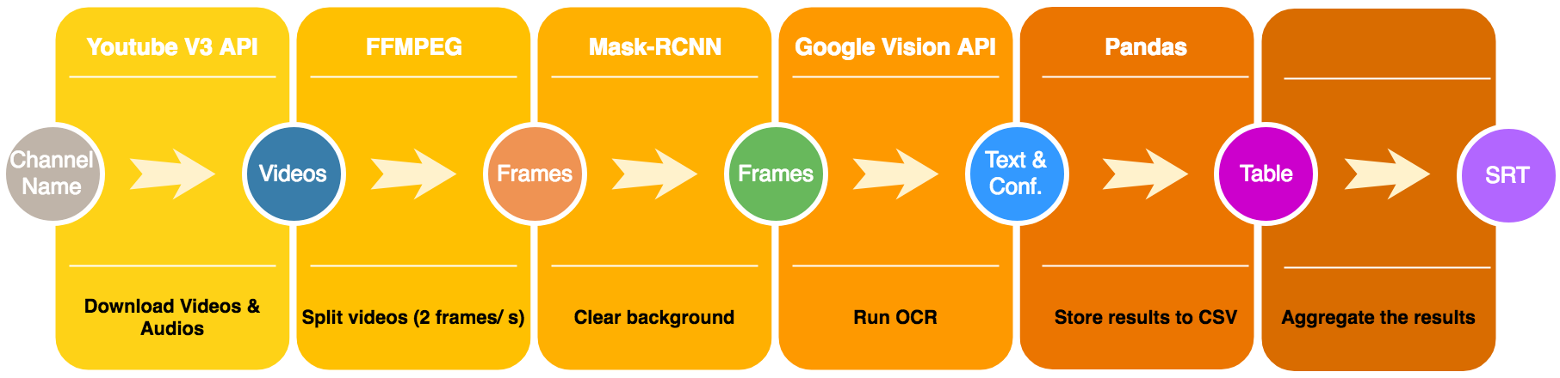
Pipeline

Slide 5
Challenges

Slide 6
Challenge 1: Time Consuming
Inference time for Mask-rcnn is too long
Average time:
CPU: 5+ seconds/ frame (80 cores)
GPU: 1+ second/ frame (V100)

Slide 7
Challenge 2: Mask-RCNN Inconsistent on Animation

Slide 8
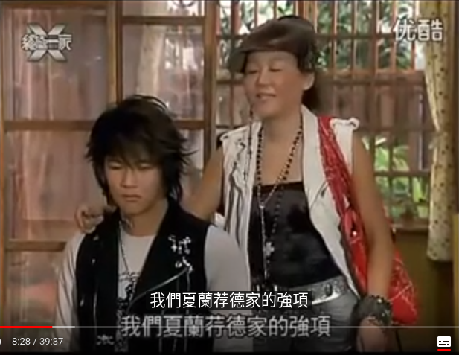
Challenge 3: Rare Words

Slide 9
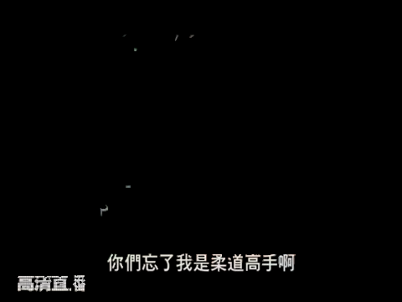
Challenge 3: Noise was not removed completely.

Slide 10
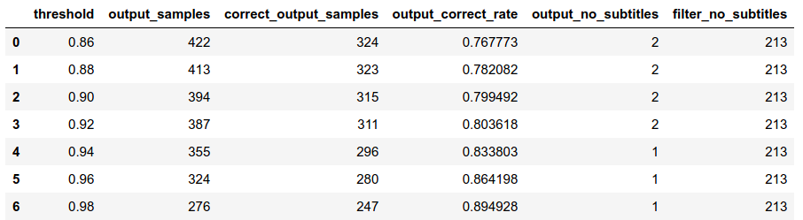
Evaluation (Mask-RCNN + Google OCR API)
Total frames: 996 (manually labelled)
Frames containing subtitles: 510

Slide 11
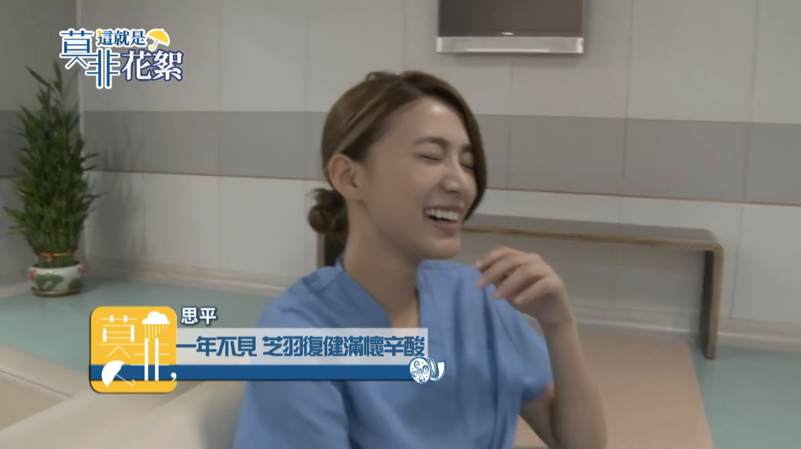
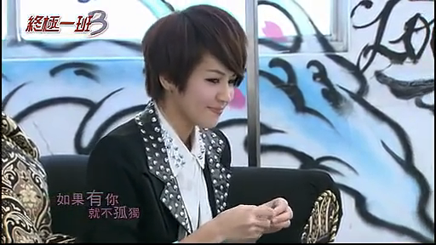
Falsely output images
思平 0.93
如果有 0.98

Slide 12
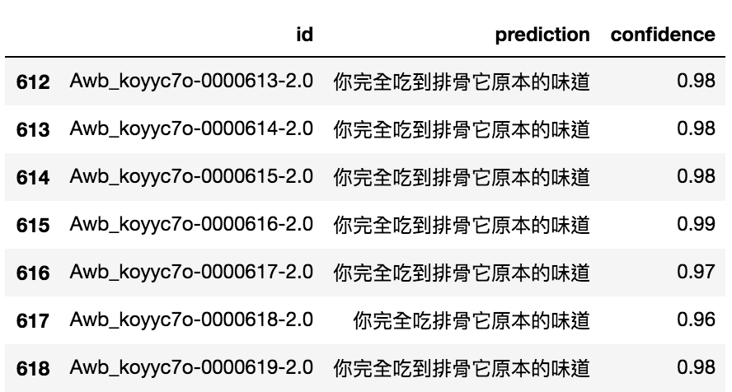
Aggregate results to generate SRT
Aggregate with the highest score
Evaluation at video-level
你完全吃到排骨它原本的味道

Slide 13
Aggregate results to generate SRT
How to decide the index boundary? -> Similarity
Edit Distance
Jaccard Distance
Heuristic

Slide 14
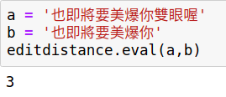
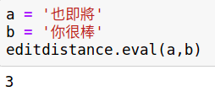
Edit Distance
Counting the number of operations required to transform one string to another.

Slide 15
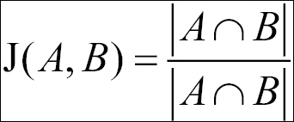
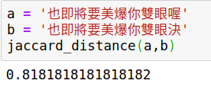
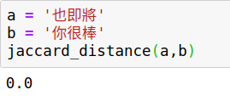
Jaccard Distance

Slide 16
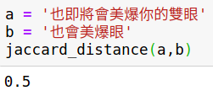
Jaccard Distance

Slide 17
Heuristic
Borrow idea from Jaccard Distance
Check if intersection matches with either string

Slide 18
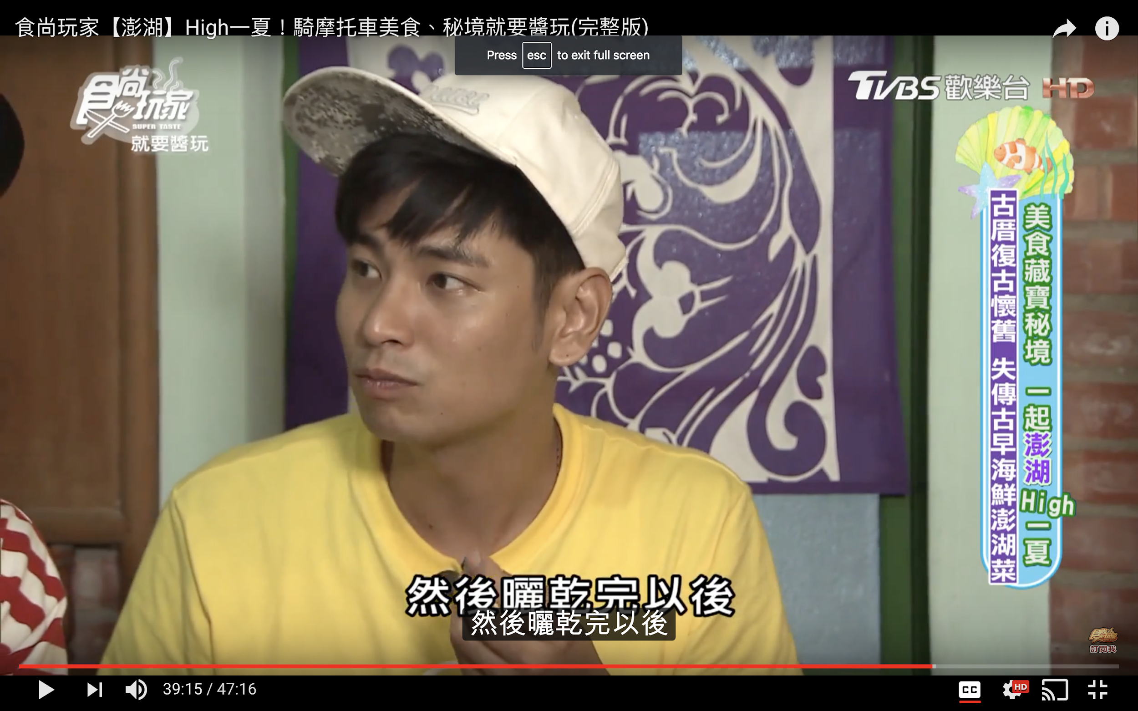
Evaluation of Aggregation Algorithm

Slide 19
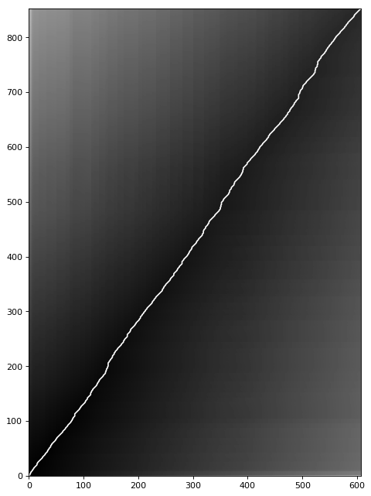
Evaluation of Aggregation Algorithm
Dynamic Time Warping

Slide 20
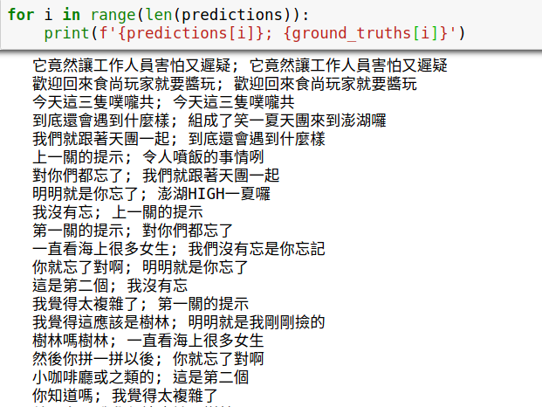
Evaluation of Aggregation Algorithm

Slide 21
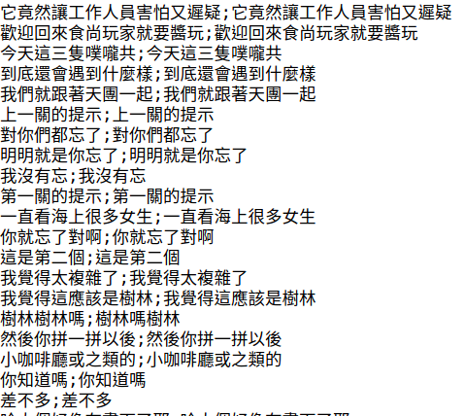
Evaluation of Aggregation algorithm

Slide 22
Evaluation of Aggregation Algorithm

Slide 23
Next Step

Slide 24
Next Step
Keep improving Mask-RCNN
Reduce cost

